Slide 1
COMSATS UNIVERSITY ISLAMABAD
Attock Campus
Artificial Intelligence
Salah Ud Din
Lecturer
Department of Computer Science
Reading Material
Chapter#1
Artificial Intelligence: A Modern Approach, Russell, S., & Norvig, P., (2013), Prentice Hall

Slide 2
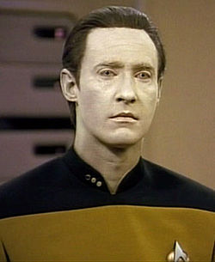
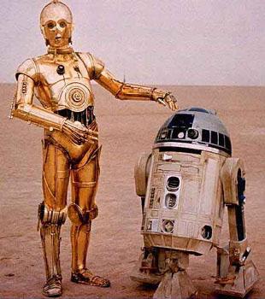




Artificial Intelligence in the Movies

Slide 3
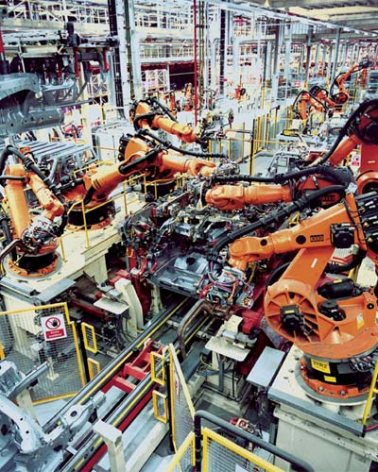
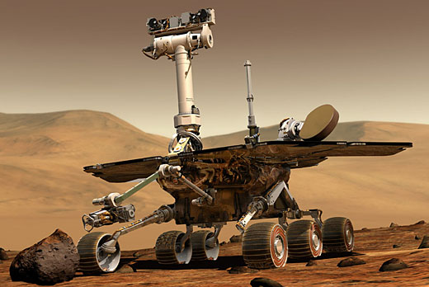
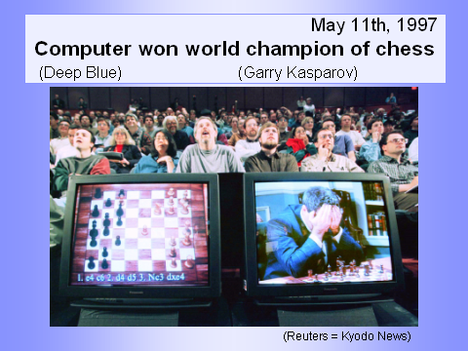
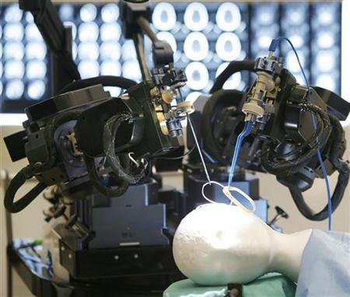
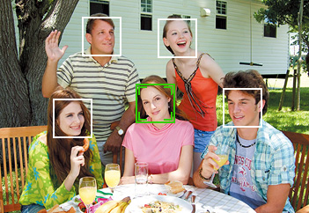
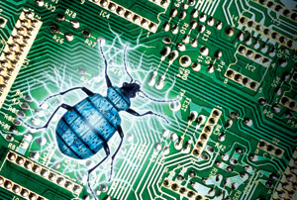
Artificial Intelligence in Real Life
A young science (≈ 50 years old)
  Exciting and dynamic field, lots of uncharted territory left
  Impressive success stories
  “Intelligent” in specialized domains
  Many application areas
Face detection
Formal verification

Slide 4
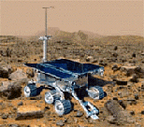

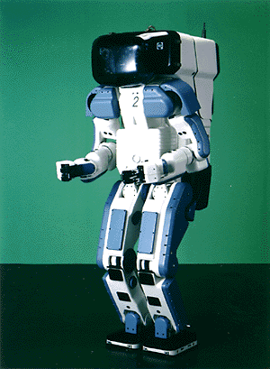

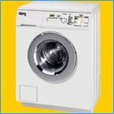
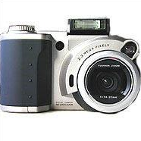

Why the interest in AI?
Search engines
Science
Medicine/
Diagnosis
Labor
Appliances
What else?

Slide 5
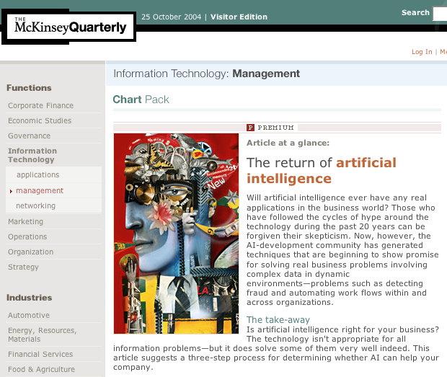

Slide 6
What is intelligence?
Intelligence is the computational part of the ability to achieve goals in the world. Varying kinds and degrees of intelligence occur in people, many animals and some machines.
Is there a “holistic” definition for intelligence? Here are some definitions:
the ability to comprehend; to understand and profit from experience
a general mental capability that involves the ability to reason, plan, solve problems, think abstractly, comprehend ideas and language, and learn
is effectively perceiving, interpreting and responding to the environment
None of these tells us what intelligence is, so instead, maybe we can enumerate a list of elements that an intelligence must be able to perform:
  perceive, reason and infer, solve problems, learn and adapt, apply common sense, apply analogy, recall, apply intuition, reach emotional states, achieve self-awareness

Slide 7
What is artificial intelligence?
There is no clear consensus on the definition of AI
John McCarthy coined the phrase AI in 1956
It is the science and engineering of making intelligent machines, especially intelligent computer programs.
It is related to the similar task of using computers to understand human or other intelligence, but AI does not have to confine itself to methods that are biologically observable.
Computers were thought of as an electronic brains
Term “Artificial Intelligence” coined by John McCarthy
  John McCarthy also created Lisp in the late 1950s
Alan Turing defines intelligence as passing the Imitation Game (Turing Test)

Slide 8
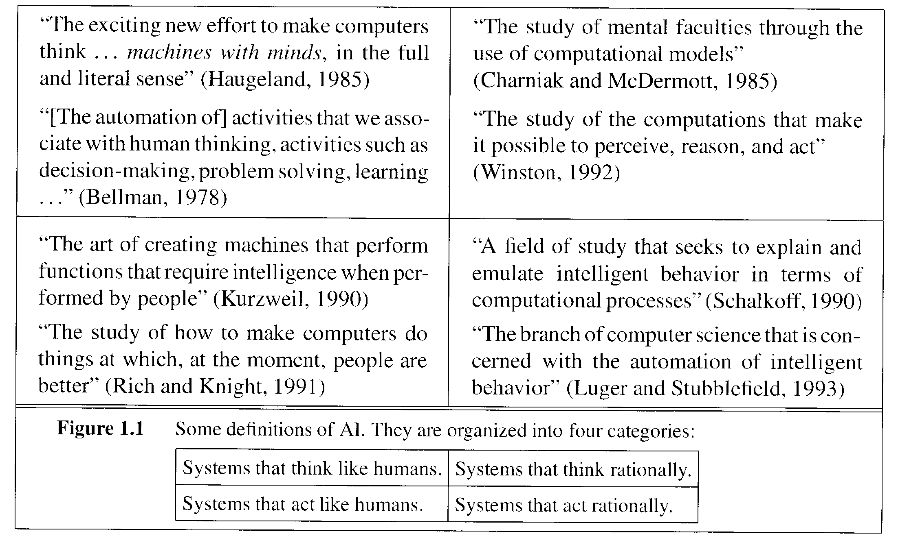
What is AI? (Cont’d)

Slide 9
What is Artificial Intelligence ?
THOUGHT
Systems that think
like humans
Systems that think
rationally
Systems that act
like humans
Systems that act
rationally
BEHAVIOUR
HUMAN
RATIONAL

Slide 10
Systems that act like humans:
Turing Test
“The art of creating machines that perform functions that require intelligence when performed by people.” (Kurzweil)
“The study of how to make computers do things at which, at the moment, people are better.” (Rich and Knight)

Slide 11
Systems that act like humans
?
You enter a room which has a computer terminal. You have a fixed period of time to type what you want into the terminal, and study the replies. At the other end of the line is either a human being or a computer system.
If it is a computer system, and at the end of the period you cannot reliably determine whether it is a system or a human, then the system is deemed to be intelligent.

Slide 12
Systems that act like humans
The Turing Test approach
  a human questioner cannot tell if
    there is a computer or a human answering his question, via teletype (remote communication)
  The computer must behave intelligently
Intelligent behavior
  to achieve human-level performance in all cognitive tasks

Slide 13
Systems that act like humans
These cognitive tasks include:
  Natural language processing
    for communication with human
  Knowledge representation
    to store information effectively & efficiently
  Automated reasoning
    to retrieve & answer questions using the stored information
  Machine learning
    to adapt to new circumstances

Slide 14
The total Turing Test
Includes two more issues:
  Computer vision
    to perceive objects (seeing)
  Robotics
    to move objects (acting)

Slide 15
What is Artificial Intelligence ?
THOUGHT
Systems that think
like humans
Systems that think
rationally
Systems that act
like humans
Systems that act
rationally
BEHAVIOUR
HUMAN
RATIONAL

Slide 16
Systems that think like humans: cognitive modeling
Humans as observed from ‘inside’
How do we know how humans think?
  Introspection vs. psychological experiments
Cognitive Science
“The exciting new effort to make computers think … machines with minds in the full and literal sense” (Haugeland)
“[The automation of] activities that we associate with human thinking, activities such as decision-making, problem solving, learning …” (Bellman)

Slide 17
Thinking Humanly: Cognitive Science
1960 “Cognitive Revolution”: information-processing psychology replaced behaviorism
Cognitive science brings together theories and experimental evidence to model internal activities of the brain
  What level of abstraction? “Knowledge” or “Circuits”?
  How to validate models?
    Predicting and testing behavior of human subjects (top-down)
    Direct identification from neurological data (bottom-up)
    Building computer/machine simulated models and reproduce results (simulation)

Slide 18
What is Artificial Intelligence ?
THOUGHT
Systems that think
like humans
Systems that think
rationally
Systems that act
like humans
Systems that act
rationally
BEHAVIOUR
HUMAN
RATIONAL

Slide 19
Thinking Rationally: Laws of Thought
Aristotle (~ 450 B.C.) attempted to codify “right thinking”
What are correct arguments/thought processes?
E.g., “Socrates is a man, all men are mortal; therefore Socrates is mortal”
Several Greek schools developed various forms of logic:
notation plus rules of derivation for thoughts.
Problems:
  Uncertainty: Not all facts are certain (e.g., the flight might be delayed).
  Resource limitations: There is a difference between solving a problem in principle and solving it in practice under various resource limitations such as time, computation, accuracy etc. (e.g., purchasing a car)

Slide 20
Systems that think ‘rationally’
"laws of thought"
Humans are not always ‘rational’
Rational - defined in terms of logic?
Logic can’t express everything (e.g. uncertainty)
Logical approach is often not feasible in terms of computation time (needs ‘guidance’)
“The study of mental facilities through the use of computational models” (Charniak and McDermott)
“The study of the computations that make it possible to perceive, reason, and act” (Winston)

Slide 21
What is Artificial Intelligence ?
THOUGHT
Systems that think
like humans
Systems that think
rationally
Systems that act
like humans
Systems that act
rationally
BEHAVIOUR
HUMAN
RATIONAL

Slide 22
Systems that act rationally:
“Rational agent”
Rational behavior: doing the right thing
The right thing: that which is expected to maximize goal achievement, given the available information
Giving answers to questions is ‘acting’.
I don't care whether a system:
  replicates human thought processes
  makes the same decisions as humans
  uses purely logical reasoning

Slide 23
Systems that act rationally
Logic → only part of a rational agent, not all of rationality
  Sometimes logic cannot reason a correct conclusion
  At that time, some specific (in domain) human knowledge or information is used
Thus, it covers more generally different situations of problems
  Compensate the incorrectly reasoned conclusion

Slide 24
Systems that act rationally
Study AI as rational agent –
2 advantages:
  It is more general than using logic only
    Because: LOGIC + Domain knowledge
  It allows extension of the approach with more scientific methodologies

Slide 25
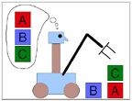
Goals of AI
To make computers more useful by letting them take over dangerous or tedious tasks from human
Understand principles of human intelligence

Slide 26
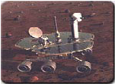
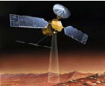
AI Applications
Autonomous Planning & Scheduling:
  Autonomous rovers.

Slide 27
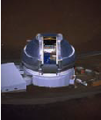

AI Applications
Autonomous Planning & Scheduling:
  Telescope scheduling

Slide 28



AI Applications
Autonomous Planning & Scheduling:
  Analysis of data:

Slide 29
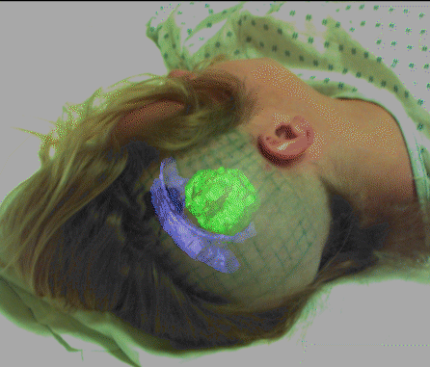

AI Applications
Medicine:
  Image guided surgery

Slide 30




AI Applications
Medicine:
  Image analysis and enhancement

Slide 31

AI Applications
Transportation:
  Autonomous vehicle control:

Slide 32

AI Applications
Transportation:
  Pedestrian detection:

Slide 33

AI Applications
Games:

Slide 34
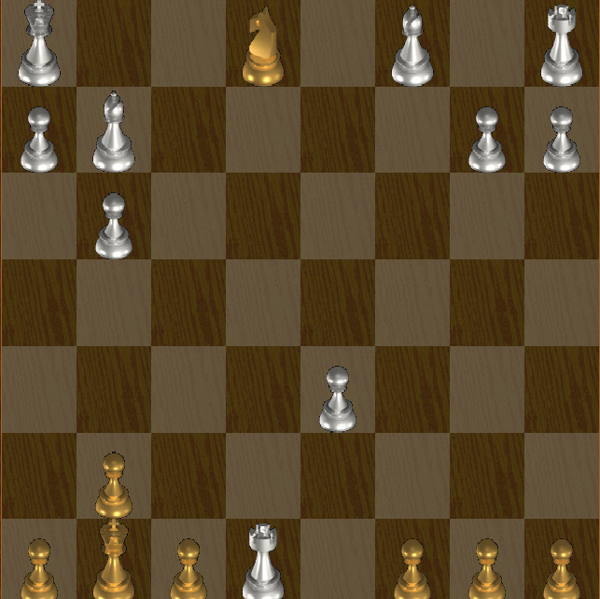
AI Applications
Games:

Slide 35

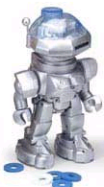
AI Applications
Robotic toys:

Slide 36
The Foundation of AI
Philosophy
  Dealt with questions like:
    Can formal rules be used to draw valid conclusions?
    Where does knowledge come from? How does it lead to action?
    David Hume proposed the principle of induction
  At that time, the study of human intelligence began with no formal expression
  Initiate the idea of mind as a machine and its internal operations

Slide 37
The Foundation of AI
Mathematics formalizes the three main area of AI: computation, logic, and probability
  Computation leads to analysis of the problems that can be computed
    complexity theory
  Probability contributes the “degree of belief” to handle uncertainty in AI
  Decision theory combines probability theory and utility theory (bias)

Slide 38
The Foundation of AI
Psychology
  How do humans think and act?
  The study of human reasoning and acting
  Provides reasoning models for AI
  Strengthen the ideas
    humans and other animals can be considered as information processing machines

Slide 39
The Foundation of AI
Computer Engineering
  How to build an efficient computer?
  Provides the artifact that makes AI application possible
  The power of computer makes computation of large and difficult problems more easily
  AI has also contributed its own work to computer science, including: time-sharing, the linked list data type, OOP, etc.

Slide 40
The Foundation of AI
Control theory and Cybernetics
  How can artifacts operate under their own control?
  The artifacts adjust their actions
    To do better for the environment over time
    Based on an objective function and feedback from the environment
  Not limited only to linear systems but also other problems
    as language, vision, and planning, etc.

Slide 41
The Foundation of AI
Linguistics
  For understanding natural languages
    different approaches has been adopted from the linguistic work
  Formal languages
  Syntactic and semantic analysis
  Knowledge representation

Slide 42
Other possible AI definitions
AI is a collection of hard problems which can be solved by humans and other living things, but for which we don’t have good algorithms for solving.
  e. g., understanding spoken natural language, medical diagnosis, circuit design, learning, self-adaptation, reasoning, chess playing, proving math theories, etc.
• Russsell & Norvig: a program that
  Acts like human (Turing test)
  Thinks like human (human-like patterns of thinking steps)
  Acts or thinks rationally (logically, correctly)
• Some problems used to be thought of as AI but are now considered not
  e. g., compiling Fortran in 1955, symbolic mathematics in 1965, pattern recognition in 1970, what for the future?

Slide 43
AI Purposes
"AI can have two purposes. One is to use the power of computers to augment human thinking, just as we use motors to augment human or horse power. Robotics and expert systems are major branches of that. The other is to use a computer's artificial intelligence to understand how humans think. In a humanoid way. If you test your programs not merely by what they can accomplish, but how they accomplish it, they you're really doing cognitive science; you're using AI to understand the human mind."
- Herb Simon

Slide 44
What’s easy and what’s hard?
It’s been easier to mechanize many of the high level cognitive tasks we usually associate with “intelligence” in people
  e. g., symbolic integration, proving theorems, playing chess, some aspect of medical diagnosis, etc.
It’s been very hard to mechanize tasks that animals can do easily
  walking around without running into things
  catching prey and avoiding predators
  interpreting complex sensory information (visual, aural, …)
  modeling the internal states of other animals from their behavior
  working as a team (ants, bees)
Is there a fundamental difference between the two categories?
Why are some complex problems (e.g., solving differential equations, database operations) are not subjects of AI?

Slide 45
History of AI
AI has roots in a number of scientific disciplines
  computer science and engineering (hardware and software)
  philosophy (rules of reasoning)
  mathematics (logic, algorithms, optimization)
  cognitive science and psychology (modeling high level human/animal thinking)
  neural science (model low level human/animal brain activity)
  linguistics
The birth of AI (1943 – 1956)
  McCulloch and Pitts (1943): simplified mathematical model of neurons (resting/firing states) can realize all propositional logic primitives (can compute all Turing computable functions)
  Alan Turing: Turing machine and Turing test (1950)
  Claude Shannon: information theory; possibility of chess playing computers
  Boole, Aristotle, Euclid (logics, syllogisms)

Slide 46
Early enthusiasm (1952 – 1969)
  1956 Dartmouth conference
  John McCarthy (Lisp);
  Marvin Minsky (first neural network machine);
  Alan Newell and Herbert Simon (GPS);
  Emphasis on intelligent general problem solving
  GSP (means-ends analysis);
  Lisp (AI programming language);
    Resolution by John Robinson (basis for automatic theorem proving);
  heuristic search (A*, AO*, game tree search)
Emphasis on knowledge (1966 – 1974)
  domain specific knowledge is the key to overcome existing difficulties
  knowledge representation (KR) paradigms
  declarative vs. procedural representation

Slide 47
Knowledge-based systems (1969 – 1999)
  DENDRAL: the first knowledge intensive system (determining 3D structures of complex chemical compounds)
  MYCIN: first rule-based expert system (containing 450 rules for diagnosing blood infectious diseases)
  EMYCIN: an ES shell
  PROSPECTOR: first knowledge-based system that made significant profit (geological ES for mineral deposits)
AI became an industry (1980 – 1989)
  wide applications in various domains
  commercially available tools
  AI winter
Current trends (1990 – present)
  more realistic goals
  more practical (application oriented)
  distributed AI and intelligent software agents
  resurgence of natural computation - neural networks and emergence of genetic algorithms – many applications
  dominance of machine learning (big apps)

Slide 48
AI is Controversial
AI Winter – too much promised
1966: the failure of machine translation,
1970: the abandonment of connectionism,
1971−75: DARPA's frustration with the Speech Understanding Research program at Carnegie Mellon University
1973: the large decrease in AI research in the United Kingdom in response to the Lighthill report,
1973−74: DARPA's cutbacks to academic AI research in general,
1987: the collapse of the Lisp machine market,
1988: the cancellation of new spending on AI by the Strategic Computing Initiative
1993: expert systems slowly reaching the bottom
1990s: the quiet disappearance of the fifth-generation computer project's original goals,
AI will cause
  social ills, unemployment
  End of humanity

Slide 49
Strong AI
"I find it useful to distinguish what I will call "strong" AI from "weak" or "cautious" AI. According to weak AI, the principle value of the computer in the study of the mind is that it gives us a very powerful tool. For example, it enables us to formulate and test hypothesis in a more rigourous and precise fashion. But according to strong AI, the computer is not merely a tool in the study of the mind; rather, the appropriately programmed computer really is a mind, in the sense that computers given the right programs can be literally said to understand and have other cognitive states."
[Searle, 1980, Minds, Brains and Programs]

Slide 50
Weak and Strong AI Claims
Weak AI:
  Machines can be made to act as if they were intelligent.
Strong AI:
  Machines that act intelligently have real, conscious minds.

Slide 51
Eliza
Called after Eliza Doolittle of Pygmalion fame.
Developed in 1964-1966 by Joseph Weizenbaum in MIT
Models (parodies) the rôle of a Rogerian psychotherapist engaged in an initial interview with a patient. Much or the technique of the Rogerian psychotherapist involves drawing the patient out by reflecting the patient’s statements back at him.
http://www-ai.ijs.si/eliza/eliza.html

Slide 52
Eliza
Men are all alike
IN WHAT WAY
They’re always bugging us about something or other.
CAN YOU THINK OF A SPECIFIC EXAMPLE
Well, my boyfriend made me come here.
YOUR BOYFRIEND MADE YOU COME HERE
He says I am depressed much of the time.
I AM SORRY TO HEAR YOU ARE DEPRESSED
It’s true. I am unhappy.
DO YOU THINK COMING HERE WILL HELP YOU NOT TO BE UNHAPPY
I need some help, that much seems certain.
WHAT WOULD IT MEAN TO YOU IF YOU GOT SOME HELP
Perhaps I could learn to get along with my mother.

Slide 53
Eliza
TELL ME MORE ABOUT YOUR FAMILY
My mother takes care of me.
WHO ELSE IN YOUR FAMILY TAKES CARE OF YOU
My father.
YOUR FATHER
You are like my father in some ways
WHAT RESEMBLANCE DO YOU SEE
You are not very aggressive but I think you don’t want me to notice that.
WHAT MAKES YOU THINK I AM NOT VERY AGGRESSIVE
You don’t argue with me
WHY DO YOU THINK I DON’T ARGUE WITH YOU

Slide 54
What is/was Eliza?
A chatterbot
Turing test competitor
A friend
A model for other bots

Slide 55
What is a chatterbot?
Conversational AI
A Chatterbot is a program that attempts to simulate typed conversation, with the aim of at least temporarily fooling a human into thinking they were talking to another person.
  Simon Laven
Chatterbot competitions
http://www.simonlaven.com/

Slide 56
What is a chatterbot?
A chatter robot, chatterbot, chatbot, or chat bot is a computer program designed to simulate an intelligent conversation with one or more human users via auditory or textual methods, primarily for engaging in small talk.
  The primary aim of such simulation has been to fool the user into thinking that the program's output has been produced by a human (the Turing test).
  Programs playing this role are sometimes referred to as Artificial Conversational Entities, talk bots or chatterboxes.
  Uses:
    chatterbots are often integrated into dialog systems for various practical purposes such as online help, personalised service, or information acquisition.
    Spam in chatrooms
  Some chatterbots use sophisticated natural language processing systems, but many simply scan for keywords within the input and pull a reply with the most matching keywords, or the most similar wording pattern, from a textual database.
  Collections:
http://www.simonlaven.com/

Slide 57
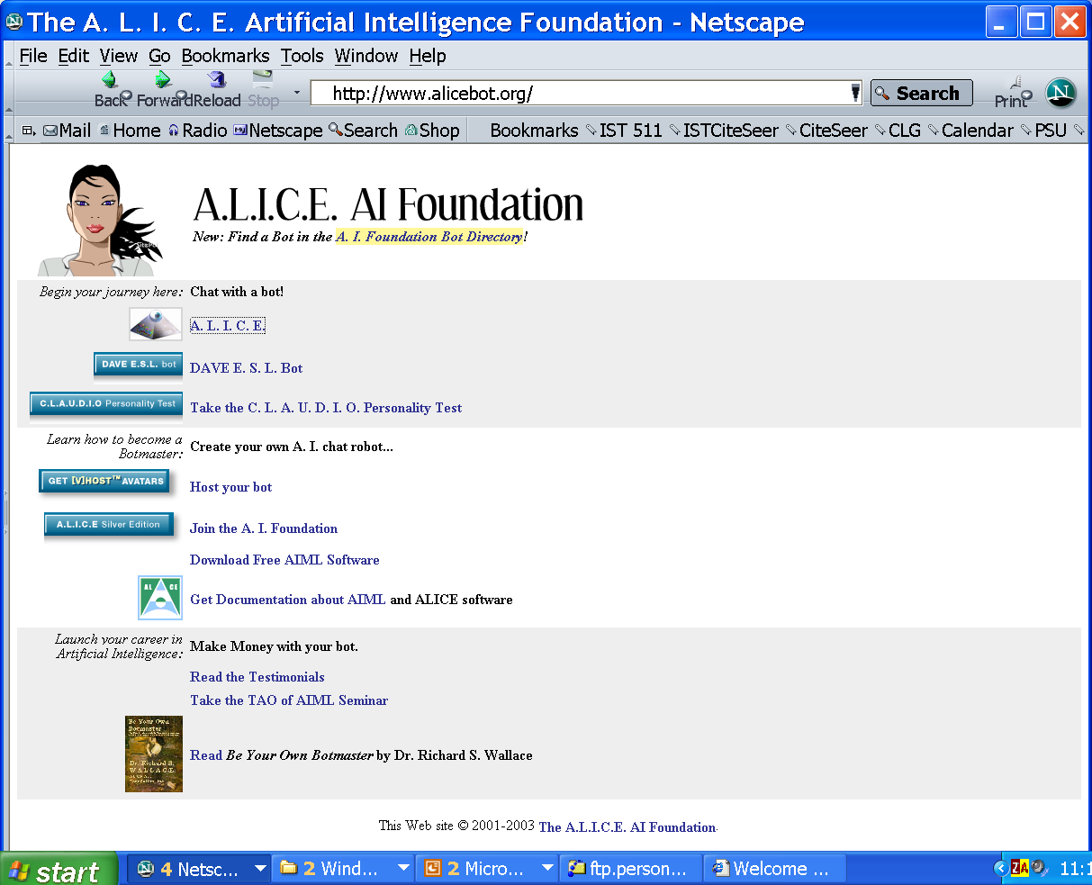
Alice www.alicebot.org

Slide 58
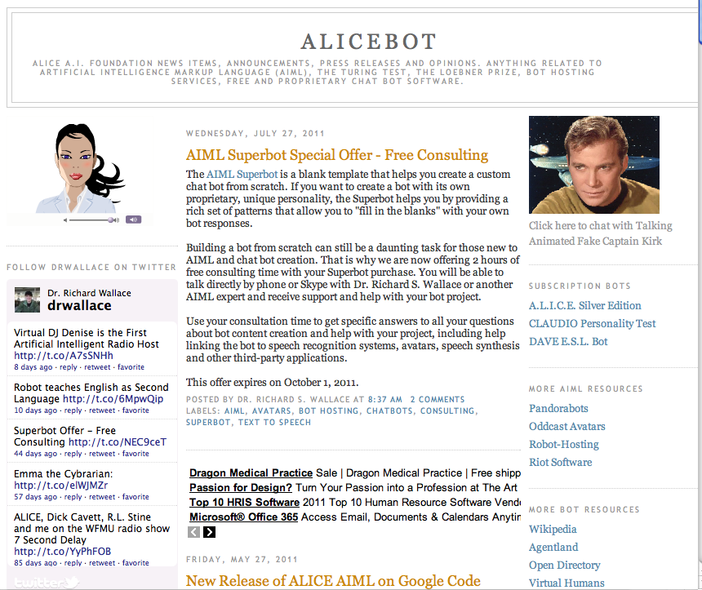
A.L.I.C.E

Slide 59
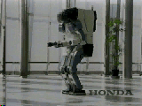
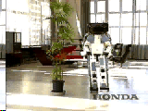
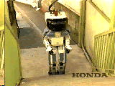
Honda Humanoid Robot
Walk
Turn
Stairs

Slide 60
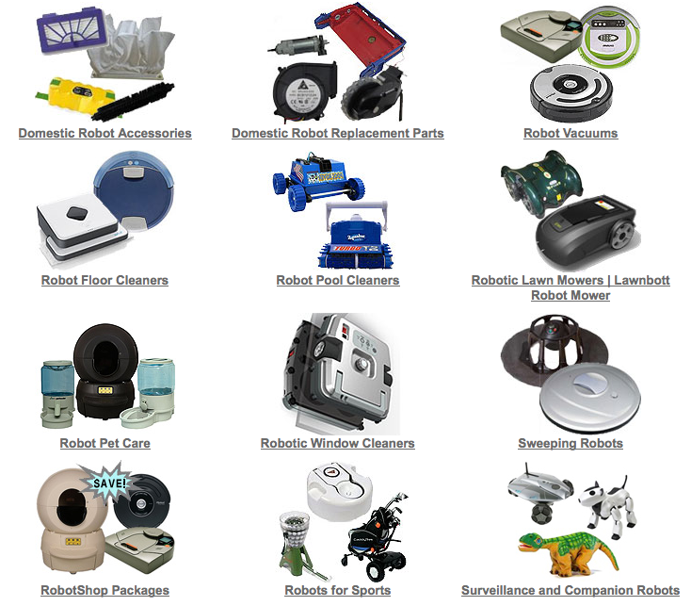
Domestic Robots

Slide 61
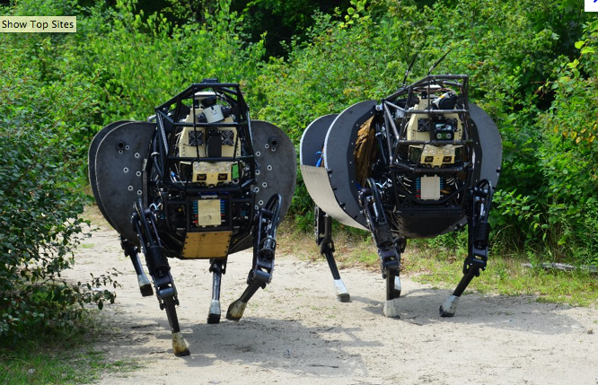
Military robots

Slide 62
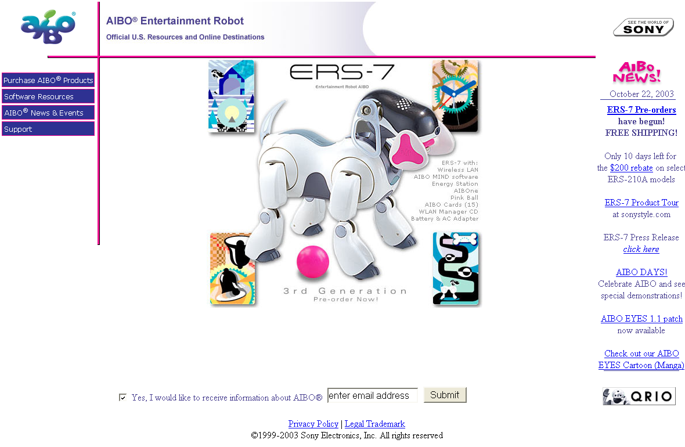
www.aibo.com

Slide 63
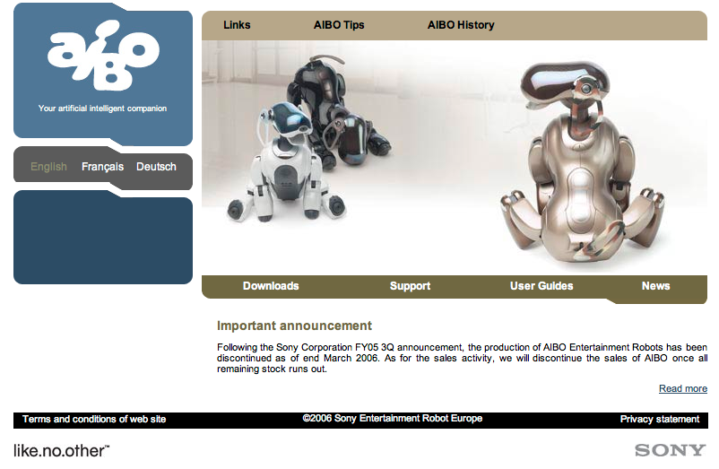

Slide 64
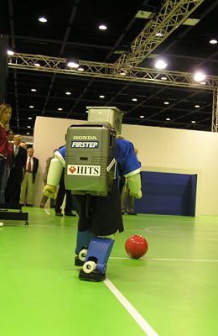
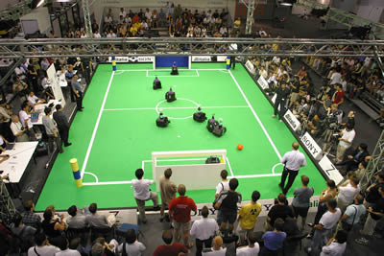
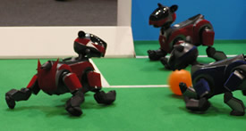
Robocup
www.robocup.org

Slide 65
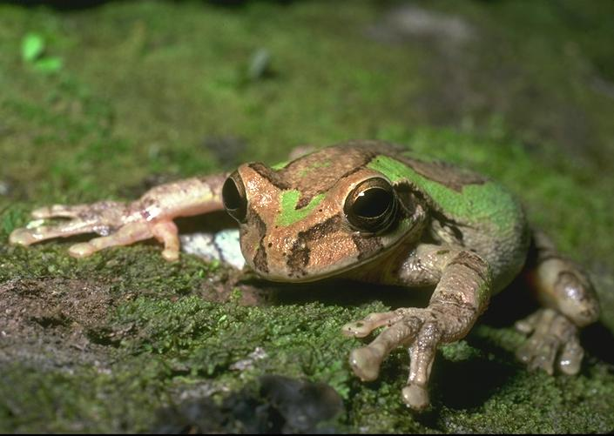
How far have we got?
General intelligence of a frog?

Slide 66
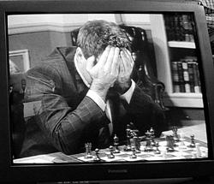

But then ask Garry K.
But don’t try to ask Deep Blue

Slide 67
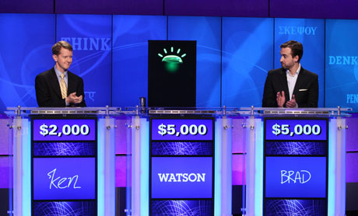
Watson
“The goal is to have computers start to interact in natural human terms across a range of applications and processes, understanding the questions that humans ask and providing answers that humans can understand and justify” - IBM

Slide 68

Watson
IBM’s Artificial Intelligence computer system
Capable of answering questions in natural language
Competed against champions on Jeopardy and won

Slide 69
Watson
IBM describes this AI as:
"an application of advanced Natural Language Processing, Information Retrieval, Knowledge Representation and Reasoning, and Machine Learning technologies to the field of open domain question answering“
What this means…

Slide 70
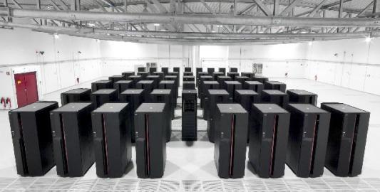
Watson
Specifics
  16 Terabytes of RAM
  Can process 500 gigabytes (1 million books) per second
  Content was stored in Watson’s RAM rather than memory to be more easily accessed
  Cost about $3 Million

Slide 71

Watson’s sources of information
Encyclopedias
Dictionaries
Thesauri
Newswire articles
Literary works
Databases, taxonomies, and ontologies.
Wikipedia articles
And more

Slide 72
How Watson Works
Receives the clues (questions) as electronic texts
It then divides these texts into different keywords and sentence fragments and searches for statistically related phrases
Quickly executes thousands of language analysis algorithms
The more algorithms that find the same answer increase Watson’s confidence of his answer and it calculates whether or not to make a guess

Slide 73
How to achieve AI?
How is AI research and engineering done?
AI research has both theoretical and experimental sides. The experimental side has both basic and applied aspects.
Competitions!
There are two main lines of research:
  One is biological, based on the idea that since humans are intelligent, AI should study humans and imitate their psychology or physiology.
  The other is phenomenal, based on studying and formalizing common sense facts about the world and the problems that the world presents to the achievement of goals.
The two approaches interact to some extent, and both should eventually succeed. It is a race, but both racers seem to be walking. [John McCarthy]

Slide 74
Strong vs Weak AI
Strong AI is artificial intelligence that matches or exceeds human intelligence — the intelligence of a machine that can successfully perform any intellectual task that a human being can.[1]
  It is a primary goal of artificial intelligence research and an important topic for science fiction writers and futurists.
  Strong AI is also referred to as "artificial general intelligence"[2] or as the ability to perform "general intelligent action".[3]
  Science fiction associates strong AI with such human traits as consciousness, sentience, sapience and self-awareness.
Weak AI is an artificial intelligence system which is not intended to match or exceed the capabilities of human beings, as opposed to strong AI, which is. Also known as applied AI or narrow AI.
  The weak AI hypothesis: the philosophical position that machines can demonstrate intelligence, but do not necessarily have a mind, mental states or consciousness. (See philosophy of artificial intelligence or John Searle's definition of Strong AI in Chinese Room)

Slide 75
AI State of the art - applications
AI achievements:
  Facilitate and replace human decision making World-class chess and game playing
  Robots
  Automatic process control
  Understand limited spoken language
  Smarter search engines
  Engage in a meaningful conversation
  Observe and understand human emotions
  Solving mathematical problems
  Discover and prove mathematical theories
  …

